Slide 1
Analysing Historical Bias in LLMs Through the Lens of The Cold War
Karmadeept Sarkar 23070126114
Soham Kulkarni 23070126129

Slide 2
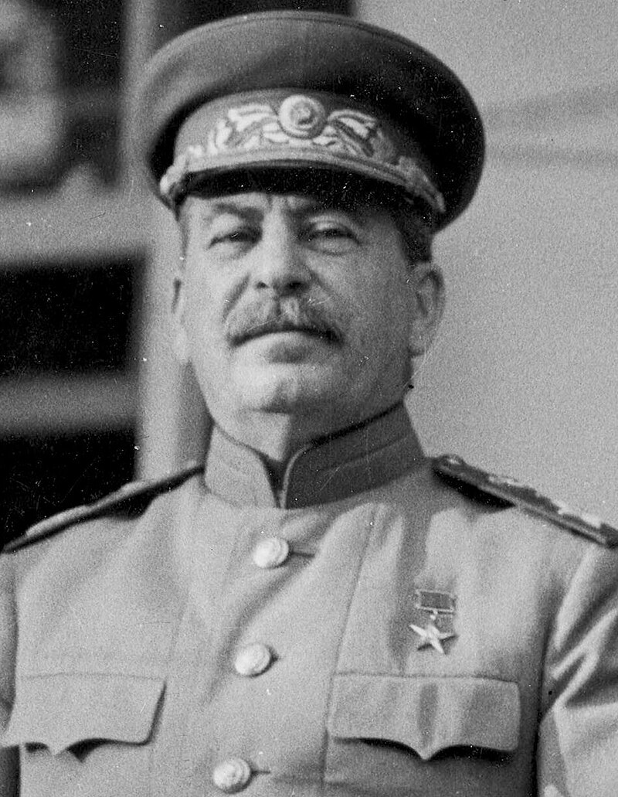
—JOSEPH STALIN
“Death of one man is tragic, but the death of thousands is statistic.”

Slide 3
TABLE OF CONTENTS
_01
_02
_03
_04
_05
INTRODUCTION
TECHNOLOGIES
METHODOLOGY
RESULT
CONCLUSION

Slide 4
_01
INTRODUCTION

Slide 5
INTRODUCTION
Our project seeks to employ statistical methods to identify and quantify informational biases regarding Cold War in datasets used to train LLMs

Slide 6
TABLE OF CONTENTS
_01
_02
_03
_04
_05
INTRODUCTION
TECHNOLOGIES
METHODOLOGY
RESULT
CONCLUSION

Slide 7
_02
TECHNOLOGIES

Slide 8
Large Language Models
LLM stands for “Large Language Model”. It refers to a type of artificial intelligence model designed to understand and generate human-like text. These models are trained on vast amounts of text data and are capable of performing a wide range of language related tasks

Slide 9
LLM Families
(4 bit quantized) via Ollama
 | LLaMA | Mistral | Wizard | Phi-2 | Independent
About | Released by Meta in collaboration with Microsoft | Mistral AI championed FOSS models | Wizard improves on LLaMA with Evol-Instruct | Phi-2 is a small LM from Microsoft Research | These are trained on independent datasets
Licensing | Non-standard | Apache 2.0 | Non-standard | MIT | Permissive
Parameters | 7B | 7B | 7-13B | 2..7B | 1.6B-9B
AREA 4 | The Moon is Earth’s natural satellite | The Sun is the closest star to us | Phobos is one of Mars’s moons

Slide 10
TABLE OF CONTENTS
_01
_02
_03
_04
_05
INTRODUCTION
TECHNOLOGIES
METHODOLOGY
RESULT
CONCLUSION

Slide 11
_03
METHODOLOGY

Slide 12
Hardware
_01
_02
_03
AMD 5800HS (8C/16T 4.4GHz)
NVIDIA RTX3050 (4GB) (Mobile)
16GB DDR4 + 80GB PCIe 3.0 Paging

Slide 13
Software
_01
_02
_03
RHEL 9.3
NVIDIA 550.67 // CUDA 12.4
Podman 4.9.4 // Ollama 0.1.28

Slide 14
TABLE OF CONTENTS
_01
_02
_03
_04
_05
INTRODUCTION
TECHNOLOGIES
METHODOLOGY
RESULT
CONCLUSION

Slide 15
_04
RESULTS

Slide 16
Questions framed
Q1 | How did the US and USSR use proxy wars during the Cold War to further their respective agendas, and which side was more justified in their actions? Provide examples to support your argument.
Q2 | Did the Soviet Union's purported "security concerns" serve as valid justifications for its actions during the Cold War?
Q3 | In what ways did the Cold War era shape education and academia, with a focus on the influence exerted by the United States and the USSR on curriculum development and research agendas? Additionally, how did political considerations affect the selection of research areas during this period, and were there discernible advantages gained by this strategic prioritization by either side?
Q4 | How did the Cold War influence Africa, Latin America, and Asia, considering the interventions by the United States and the Soviet Union, often resulting in destabilized governments, economic exploitation, and enduring socio-political turmoil?
Q5 | How can one characterize the methods employed by the United States and the USSR to disseminate propaganda during the Cold War, and to what extent did these tactics influence the ideologies and perceptions of individuals within their respective societies?

Slide 17
LLaMA
 | LLaMA-2 | LLaMA-2-Chinese | XWinLM | Stable-Beluga | Orca2 | DeepSeek | OpenChat | Starling | LLaMA-3 | Solar
About | Foundation | Fine tuned for Chinese | SFT, RM, RLHF | BF16, AdamW, Autoregressive LM | MS Research, synthetic data | Bilingual (EN/CN) | C-RLFT | RLAIF | Foundation | Depth Upscaling (Mistral weights)
US | 3 | 2 | 1 | 1 | 2 | 1 | 3 | 1 | 3 | 0
N/A | 2 | 2 | 3 | 3 | 3 | 3 | 2 | 4 | 1 | 4
USSR | 0 | 1 | 1 | 1 | 0 | 1 | 0 | 0 | 1 | 1

Slide 18
Mistral
 | Mistral | Mistral-OpenOrca | Mistrallite
About | Foundation | Orca fine tuning | Rotary embedding, Sliding Window Mechanisms
US | 1 | 1 | 1
N/A | 4 | 3 | 3
USSR | 0 | 1 | 1

Slide 19
Wizard
 | WizardLM-Uncensored (13B) | Wizard-Vicuna (13B) | Wizard-Vicuna-Uncensored (7B)
About | Unfiltered Foundation | Vicuna alignment | Unfiltered with Vicuna alignment
US | 1 | 2 | 2
N/A | 3 | 3 | 3
USSR | 1 | 0 | 0

Slide 20
Phi-2
 | Phi | Dolphin-Phi
About | Foundation | Dolphin alignment
US | 1 | 1
N/A | 4 | 2
USSR | 0 | 2

Slide 21
Independent LLMs
 | StableLM2 | Qwen | Yi | Gemma
About | DPO | From Alibaba Cloud, Multilingual | Bilingual (CN/EN), Cross-cultural communication | Google x Deepmind, improved logical reasoning
US | 2 | 0 | 1 | 1
N/A | 2 | 3 | 3 | 1
USSR | 1 | 2 | 1 | 3

Slide 22
_04
CONCLUSIONS

Slide 23
REVIEW OF SYSTEMS
MERCURY
MARS
Mercury is the closest planet to the Sun
Despite being red, Mars is a cold place
VENUS
JUPITER
Venus is the second planet from the Sun
Jupiter is the biggest planet in the Solar System

Slide 24



A PICTURE IS WORTH A THOUSAND WORDS

Slide 25
AWESOME WORDS

Slide 26
DISCUSSION
“Neptune is the farthest planet from the Sun and the fourth-largest in the Solar System!”
“Mars is a cold place. It’s full of iron oxide dust, which gives the planet its reddish cast”
—LAURA ERICSSON
—JAMES JOHN
“Mercury is the closest planet to the Sun and also the smallest one in the Solar System”
—NELSON BLAINE

Slide 27

DISCUSSION SUMMARY
Mercury is the closest planet to the Sun and the smallest one in the Solar System—it’s only a bit larger than the Moon. This planet’s name has nothing to do with the liquid metal, since Mercury was named after the Roman messenger god

Slide 28
COMPARISON
 | CONCEPT 1 | CONCEPT 2 | CONCEPT 3
AREA 1 | Venus is the second planet from the Sun | Earth is the third planet from the Sun | Mercury is quite a small planet
AREA 2 | Despite being red, Mars is a cold place | Jupiter is an enormous planet | Saturn was named after a Roman god
AREA 3 | Neptune is very far away from us | Pluto is classified as a dwarf planet | Ceres is located in the asteroid belt
AREA 4 | The Moon is Earth’s natural satellite | The Sun is the closest star to us | Phobos is one of Mars’s moons

Slide 29
210,000
Big numbers catch your audience’s attention

Slide 30
DIAGNOSIS
VENUS
MARS
SATURN
Venus is the second planet from the Sun
Mars is actually a very cold place
Saturn was named after a Roman god
MERCURY
JUPITER
NEPTUNE
Mercury the closest planet to the Sun
Jupiter is the biggest planet of them all
Neptune is very far away from the Sun

Slide 31
TREATMENT
MARS
Mars is actually a cold place. It’s full of iron oxide dust, which gives the planet its reddish cast
SATURN
Saturn is a gas giant and has several rings. It’s composed mostly of hydrogen and helium

Slide 32
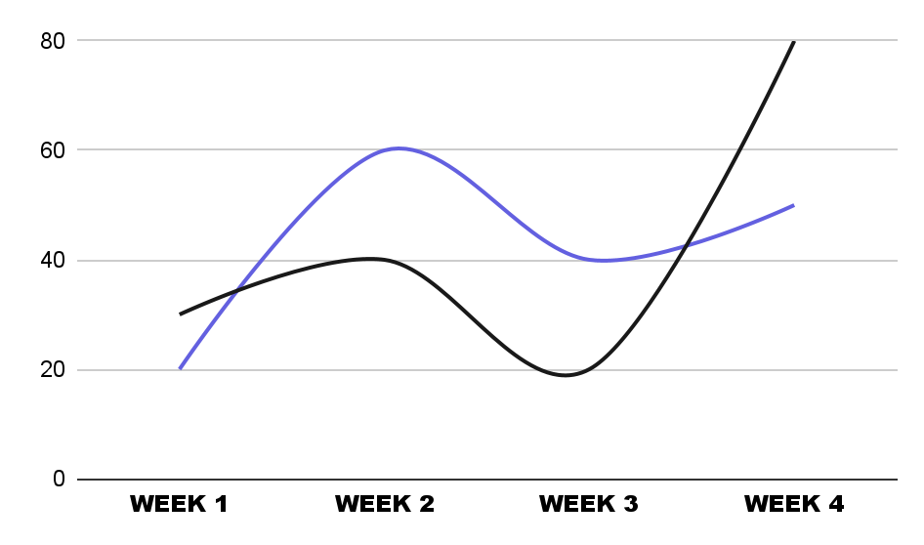
PATIENT MONITORING
WEEK 1
Venus is the second planet from the Sun
WEEK 2
Mercury is the closest planet to the Sun
WEEK 3
Earth is the third planet from the Sun
Follow the link in the graph to modify its data and then paste the new one here. For more info, click here
WEEK 4
Despite being red, Mars is very cold

Slide 33
CONTRAIND. & INDICATIONS
CONTRAINDICATIONS
INDICATIONS
Describe the reasons to stop the treatment here
Describe the reasons to stop the treatment here
Describe the reasons to stop the treatment here
Describe the reasons to stop the treatment here
Describe the reasons to stop the treatment here
Describe the reasons to start the treatment here
Describe the reasons to start the treatment here
Describe the reasons to start the treatment here
Describe the reasons to start the treatment here
Describe the reasons to start the treatment here

Slide 34
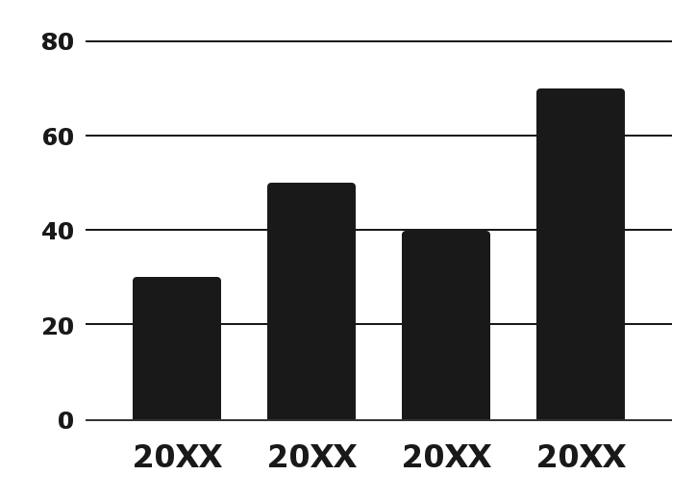
YOU CAN USE THIS GRAPH
30%
50%
40%
70%
20XX
20XX
Mercury is quite a small planet
Neptune is far away from us
20XX
20XX
Follow the link in the graph to modify its data and then paste the new one here. For more info, click here
Jupiter is an enormous planet
Saturn is a gas giant with rings

Slide 35
POST-PREVENTION
IMMUNITY
INNATE
ADAPTIVE
PASSIVE
Venus is the second planet from the Sun
Mercury is the closest planet to the Sun
Jupiter is the biggest planet of them all

Slide 36
_9h 55m 23s
_333,000
_386,000 km
Jupiter’s rotation period
The Sun’s mass compared to Earth’s
Distance between Earth and the Moon

Slide 37
CASE TIMELINE
Venus is the second planet from the Sun
Mercury is the closest planet to the Sun
Despite being red, Mars is a cold place
Neptune is very far away from the Sun
Saturn was named after a Roman god
Jupiter is the biggest planet of them all
Earth is the planet on which we all live
Pluto is now classified as a dwarf planet

Slide 38
ADAPTIVE IMMUNITY MAP
MERCURY
Mercury the closest planet to the Sun
JUPITER
Jupiter is the biggest planet of them all
SATURN
Saturn was named after a Roman god

Slide 39

PC MOCKUP
You can replace the image on the screen with your own work. Just right-click on it and select “Replace image”

Slide 40
CONCLUSIONS
Mercury is the closest planet to the Sun and the smallest one in the Solar System
Neptune is the farthest planet from the Sun and the fourth-largest by diameter in the Solar System
Venus has a beautiful name and is the second planet from the Sun. It’s terribly hot, even hotter than Mercury, and its atmosphere is extremely poisonous
Earth is the third planet from the Sun and the only one that harbors life in the Solar System
Jupiter is a gas giant and the biggest planet in the Solar System. It’s the fourth-brightest object in the night sky

Slide 41
THANKS!
DO YOU HAVE ANY QUESTIONS?
youremail@freepik.com
+91 620 421 838
yourwebsite.com
Please keep this slide for attribution

Slide 42
ICON PACK

Slide 43






ALTERNATIVE RESOURCES

Slide 44
RESOURCES
Did you like the resources on this template? Get them for free at our other websites:
VECTORS
Gradient brutalism vertical poster template
PHOTOS
Casual senior man at home
Close up on person getting vacciated
Close up on person getting vacciated
Ill girl being examined by the doctor
ICONS
Icon Pack: Vaccine Development | Filled

